Slide 1
NetLabs Global IT Services Pvt Ltd
Internship Completion Presentation
Industry Supervisor: Santosh Kumar Jena
Submitted by,
Megha Bharathi M
Reg No : 102CS23031
6th Sem CS Department
SJ (GOVT) Polytechnic College
Bangalore-560001
Submitted to,
Mr Raghavendra MY
Lecturer
SJ (GOVT) Polytechnic College
Head of CS Department
Haritha S M
SJ (GOVT) Polytechnic College
Bangalore-560001

Slide 2
AGENDA
1.Organization Profile
1.1 Overview of Organization
1.2 Vision and Mission
1.3 Organization Structure
1.4 Roles and Responsibility
1.5 Products and Market Performance
2.On Job Training - I
2.1 OJT – I GP-SMS Automation
2.2 OJT Learning During Internship
2.3 Technical Skills Applied
2.4 Work Performed
3.Usecase - I
3.1 Usecase - I
3.2 Usecase - I Visual Representation

Slide 3
AGENDA
4.On Job Training – II
4.1 OJT – II Agriculture Drought Prediction System
4.2 OJT Learning During Internship
4.3 Technical Skills Applied
4.4 Work Performed
5.Usecase - II
5.1 Usecase - II
5.2 Usecase - II Visual Representation
6.Conclusion

Slide 4
1.ORGANISATION PROFILE

Slide 5
1.1 Overview of the Organization
Full Name:
NetLabs Global IT Services Private Limited
Incorporated:
9 March 2016 (Indian Companies Act)
Industry Supervisor:
Santosh Kumar Jena (Team Manager)
Industry:
Managed IT Services, Emerging Technologies, Cybersecurity, Talent Solutions
Location:
B-Wing, 5th Floor, Phoenix Towers, No. 16, 16/1, Museum Road, Bangalore – 560001
USA Office:
10045 Cortez Blvd, Suite 100, Spring Hill, Florida – 34613
Global Presence:
Offices in India, USA, and Australia
Website:
www.netlabsglobal.com

Slide 6
1.2 Vision and Mission
➤ Vision Statement:
To create endless possibilities of growth and well-being for all our stakeholders – customers, employees, partners, investors and societies.
➤ Mission Statement:
We strive to be a global business transformation enabler by helping our customers adopt smart cutting-edge technologies, smart industry practices and smart people talent solutions to stay ahead of the curve.

Slide 7
1.3 Organization Structure
MD / CEO
Santosh Deshpande
NetLabs
DC Ops
EmTech
HR
Admin
Finance
Key Departments:
NetLabs & DC Ops: Infrastructure, data center and network operations
Emerging Tech (EmTech): RPA, AI, automation and product development
HR: Talent management and employee engagement
Admin: Administrative support and facilities management
Finance: Budgeting, invoicing and payment processing

Slide 8
1.4 Roles & Responsibilities
Management:
Strategic planning, decision-making and stakeholder management
Network & DC Ops:
Infrastructure management and data center operations
Emerging Tech:
RPA, AI, automation and product development
HR Department:
Talent management and employee engagement
Finance:
Budgeting, invoicing and payment processing
Sales:
Business development and client relationships

Slide 9
1.5 Products and Market Performance
Products & Solutions:
Procure X Fusion – Procurement-to-Payment automation platform
Data Center & Managed IT Services – End-to-end IT with Smart-Shoring methodology
Cyber Resilience & Compliance Solutions – Enterprise security and advisory
Talent-as-a-Service (TaaS) – Source-Train-Deploy model for talent
Market Performance:
100+ customer relationships
40+ technology partners
Clients across BFSI, Healthcare, Education, Manufacturing, Govt & PSU
Trusted by global and Indian enterprises with long-term partnerships
Offices in India, USA and Australia

Slide 10
2.On Job Training - I

Slide 11
2.1 OJT-I Role: GP-SMS Automation
Assigned Role: AI/ML Intern
Project: GP-SMS (General Physician SMS) Automation System
Core Objective: Automate processing of9 SMS backup data to generate structured reports
Technical Goals: Build backend automation pipeline for data cleaning, deduplication, merging and report generation
Core Responsibilities:
Backend data processing and pipeline automation
Handling SMS backup data and deduplication
Supporting report generation (Excel & PDF)
Assisting automation using Automation Anywhere A360 and Dashboard

Slide 12
2.2 OJT Learning During Internship
Python Concepts:
API Concepts:
Python basics and iterables
Lists, tuples, sets, dictionaries
Functions and file handling
API and REST API development
JSON request and response
HTTP methods: GET, POST, PUT, DELETE
Authentication:
APIs Built:
Token based authentication
Session based authentication
API key authentication
Authentication API
Authorization API
HRMS API
Banking APIs

Slide 13
2.3 Technical Skills Applied
Programming: Python (data processing, automation, API development)
Data Processing: Pandas (CSV handling, cleaning), NumPy (matrix operations)
Automation: Automation Anywhere A360 for backend pipeline automation
APIs & Backend: REST API development, Flask (HTTP routing), JSON handling, FastAPI
Authentication: Token-based, Session-based, API key authentication flows
Output Formats: Excel reports (.xlsx), PDF reports, Dashboard visualizations

Slide 14
2.4 Work Performed
GP-SMS Workflow:
SMS Data → Cleaning → Merge → Final Data → ML Models → Excel Output → Web Dashboard
Objectives:
Automate SMS Data Processing
Implement Incremental Data Handling
Integrate with Master Data
Generate Structured Dataset
Apply Machine Learning Models
Perform Referral Prediction
Segment Doctors Using Clustering
Detect Anomalies in Data
Visualize Data Insights
Develop Web Dashboard
Implement User Authentication
Improve Decision-Making
Output:
Excel reports, PDF reports, Dashboard

Slide 15
3.USECASE - I

Slide 16
3.1 Use Case I: GP-SMS Automation
Actors
Inputs
Outputs
• System Administrator
• SMS backup data files
• Cleaned Excel reports
• Data Processing Team
• Raw CSV/Excel records
• Dashboard visualizations
• AI/ML Intern
• Configuration parameters
• Automated notifications
• Filter and rule settings
Process Flow:
Step 1: Download SMS backup data from source systems
Step 2: Clean and filter data — remove invalid and duplicate records
Step 3: Merge datasets and validate for accuracy and completeness
Step 4: Auto-generate Excel
Step 5: Push results to dashboard and notify stakeholders

Slide 17
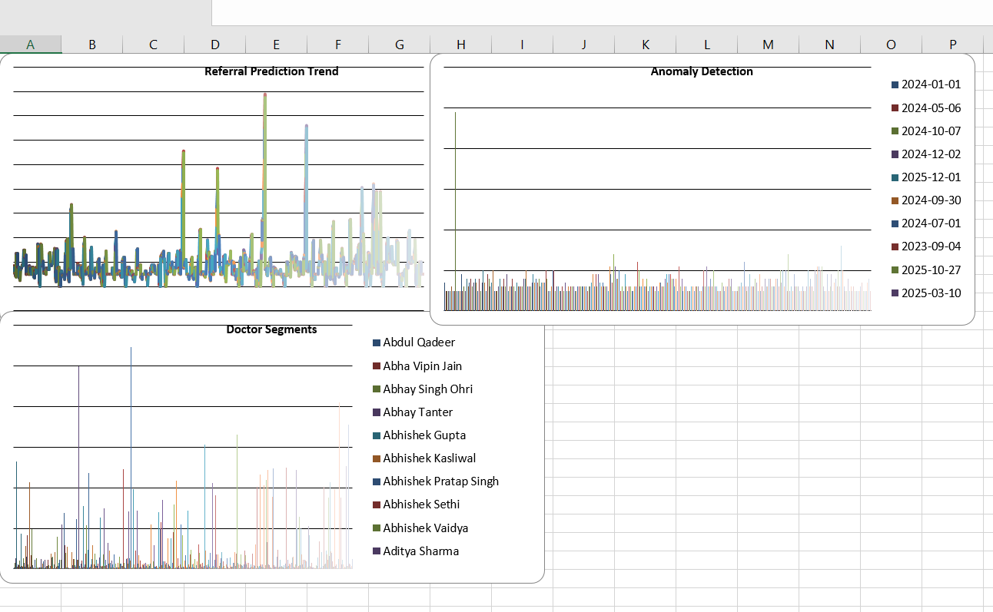
3.2 Use Case I: Visual Representation
Fig: GP-SMS Final Output – Patient Report Dashboard

Slide 18
4.On Job Training – II

Slide 19
4.1 OJT-II Role: Agriculture Drought Prediction System
Assigned Role: AI/ML Intern
Objective: Predict the likelihood of agricultural drought based on climatic and soil conditions using Machine Learning and provide preventive recommendations
Technical Goals: Develop an ML pipeline that takes environmental parameters (rainfall, temperature, humidity, soil moisture, and wind speed) as input and predicts drought occurrence with a probability score, along with actionable insights
Key Responsibilities:
API Development for Invoice Systems (Invoice, Payment, Receipt, LedgerAPIs)
Excel Data Processing and Merging from multiple files
AI/ML Model Development for Agriculture Drought Prediction
Frontend Design using HTML & CSS (Login page and Dashboard)

Slide 20
4.2 OJT Learning During Internship
Invoice System Concepts:
Learned Invoice concepts and business usage
Developed Invoice API, Payment API, Receipt API and Ledger API
Applying a payment amount to an existing invoice and updating the remaining balance
Excel & Data Processing:
Extracted invoice data into Excel
Merged datasets from multiple files
Performed record matching and validation
AI/ML Model Development:
• Trained ML models to predict drought using environmental data • Compared algorithms and selected best model • Achieved high accuracy with probability-based prediction

Slide 22
4.3 Technical Skills Applied
Machine Learning: Scikit-learn (Random Forest, Logistic Regression)
Data Processing: Pandas (CSV handling, merging), NumPy (numerical operations)
Frontend: HTML5 (Login page, Dashboard Input Form), CSS3 (Responsive styling)
Backend: Flask (HTTP routing, model inference, REST API)
APIs: Invoice API, Payment API, Receipt API, Receivable Transaction API
Excel Processing: Multi-file data extraction, merging and record matching

Slide 23
4.4 Work Performed
Agriculture Drought Prediction System:
• User logs into the system through an HTML-based login page • Enters environmental parameters: Rainfall, Temperature, Humidity, Soil Moisture, Wind Speed • Machine Learning models (Random Forest & Logistic Regression) process the input data • System predicts drought occurrence along with probability score • Displays visual analytics including doughnut chart (risk level) and bar graph (algorithm comparison) • Provides recommended actions to reduce drought impact
Result:
• Prediction Output: Drought / No Drought based on input conditions • Drought Probability: Percentage risk displayed using chart visualization • Model Performance: Best algorithm selected based on accuracy, precision, recall, and F1-score • System Output: Actionable recommendations for farmers (water conservation, crop planning, soil management)

Slide 24
5.USECASE - II

Slide 25
5.1 Use Case II: Agriculture Drought Prediction
Actors
Inputs
Outputs
• System Administrator
• Rainfall(mm)
• Farmer / End User
• Temperature(°C), Humidity(%)
• Soil Moisture(%), Windspeed (km/h)
• Drought Prediction (Drought / No Drought) • Probability Score (%) • Risk Level (Low / Moderate / Severe) • Recommended Actions (Water conservation, crop planning, etc.)
Process Flow:
• Step 1: User logs into system via HTML login page • Step 2: Enters environmental parameters (Rainfall, Temperature, Humidity, Soil Moisture, Wind Speed) • Step 3: Machine Learning models (Random Forest & Logistic Regression) process the inputs • Step 4: System predicts drought with probability score • Step 5: Results displayed — Prediction, Charts, Risk Level, and Recommendations

Slide 26
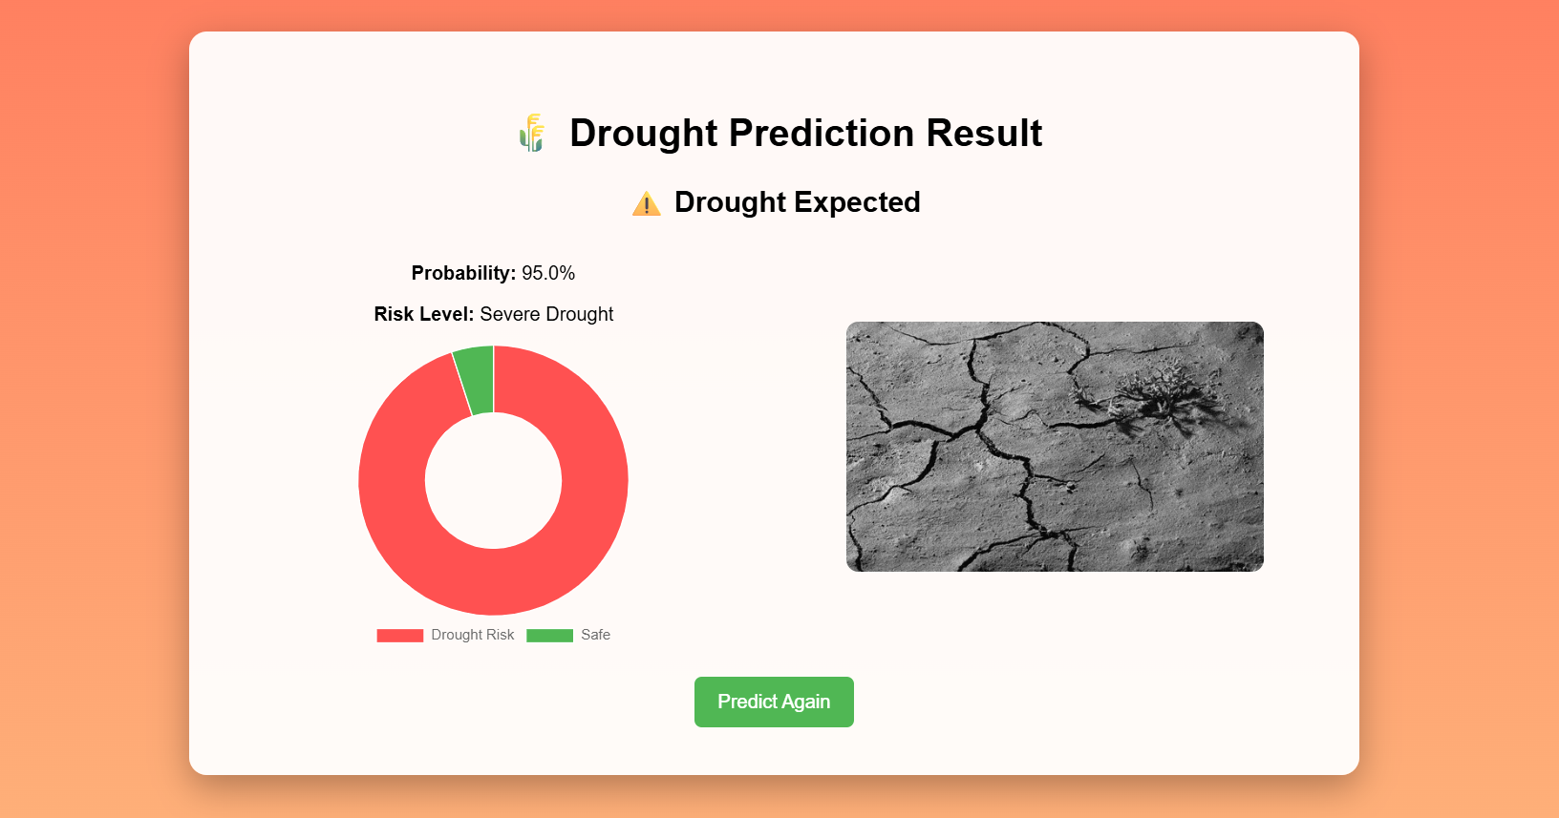
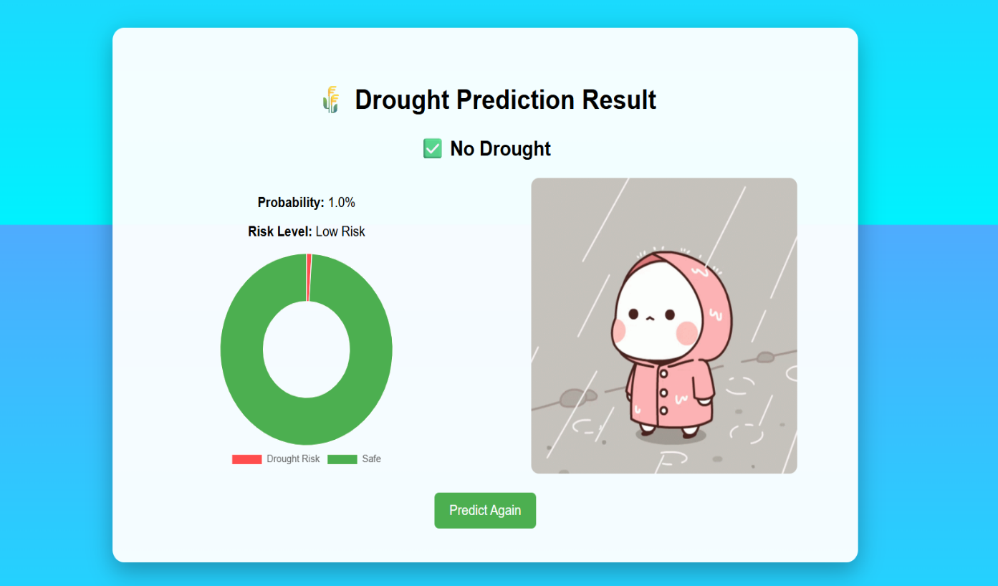
5.2 Use Case II: Visual Representation
Fig: Agriculture Drought Prediction System – Output Dashboard

Slide 27
6. CONCLUSION
This project successfully demonstrates the use of Machine Learning and Automation to solve real-world problems.
By integrating models like Random Forest and Logistic Regression, the system provides accurate and reliable predictions.
The dashboard and visualization features make the results easy to understand and support better decision-making.
Automation of data processing improves efficiency, reduces manual effort, and minimizes errors.
Overall, the project highlights how technology can enhance productivity, accuracy, and user experience in practical applications.

